Slide 1

Decentralized Traceability and Direct Marketing of Agricultural Supply Chain
by
S. Shabana
Roll No. 204G1A0595
N. Sai Charan Reddy
Roll No. 2041A0584
G. Sai Pranav Reddy
Roll No. 204G1A0590
C. Sushmitha
Roll No. 204G1A05A6
Under the guidance of
Mr. M. Narasimhulu M.Tech (Ph.D)
Associate Professor
Department of Computer Science and Engineering
Srinivasa Ramanujan Institute of Technology
(Autonomous)
2023 - 2024

Slide 2
Comments
Abstract is not clear
Check and verify proposed system
Objective should be clear
Should have an idea about Blockchain
Which software model is used

Slide 3
Contents
Abstract
Introduction
Literature Survey
Existing System
Proposed System
Planning
Design
Implementation
Research Paper
References

Slide 4
Abstract
The agriculture sector is facing the major challenges because of the absence of direct supply chain between farmers and buyers. This will lead to vulnerabilities, reduce the farmers income and compromises product quality. To address these issues, we are developing a web portal which facilitates the visibility of farmers profiles making their details accessible to the wide range of buyers. This approach lets buyers to connect with farmers through the portal, allowing them to negotiate and quickly update price agreements.
To enhance transparency and security, our system incorporates Blockchain technology to record and securely store all transactions. Our innovative web portal strives to bridge the gap between farmers and buyers promoting transparency and trust in agriculture transactions. This approach has the potential to benefit both farmers and consumers while promoting sustainable practices within the agricultural sector.
Keywords: Agriculture supply chain, Direct marketing, Blockchain, Traceability

Slide 5
Introduction
The project focus on the development of a decentralized traceability and direct marketing system for agriculture supply chains.
This innovative system empowers buyers, sellers, and administrators, fostering a more efficient and transparent marketplace.
This system streamlines the marketing process for sellers, improving their reach and efficiency. Administrators have the capability to log in, manage fixed payments, and maintain the system's integrity.
Our decentralized traceability and direct marketing system promise to revolutionize agriculture supply chains, enhancing transparency, trust, and efficiency across the industry.

Slide 6
Literature survey
A strategy that levitates the block chain and conducts business operations effectively across the agricultural supply chain for tracking crop prices and traceability. All transactions are registered and then stored in block chain’s unchangeable ledger with linkages to a decentralized network, thereby ensuring vary high degree of traceability and transparency in the supply chain ecosystem in a stable, reliable and in efficient manner[1].
Authors in[2] have proposed an approach for effective deals of soybean traceability in Agri- Food force chain. The proposed result overcomes the problems of centralized results and eliminates the need for a trusted third party. Blockchain’s transparent and immutable nature can enable farmers to have transparent visibility into transaction history, ensuring fair pricing and reducing the risk of fraud.

Slide 7
Literature survey
Food safety in recent times is a growing concern for marketable and academic diligence. utmost of the results till date are centralized and affect in serious problems similar as fraud, tampering and man- in- the- middle attack[3]. Thus, literature has introduced several blockchain- grounded traceability and information security in Agri- Food force chain systems.
author in[4] has proposed a traceability scheme grounded on Hazard Analysis and Critical Control Points( HACCP), blockchain and IoT. In traditional storehouse schemes, the data is stored in centralized storehouse. After the invention of blockchain, numerous decentralized storehouse systems are used to store the data in a decentralized manner.

Slide 8
Literature survey
In[5], authors proposed an effective storehouse scheme for Agri- Food product swerving. Authors used IPFS along with secondary database to achieve the traceability. IPFS is a network used to store and partake data in a decentralized train system.
Paper[6] has proposed an auditable protocol for transparent, tamper- evidence and empirical deals between realities. Ethereum blockchain support for online force Chain systems and its feasibility in Business- to- Consumer( B2C) business model. They propose Consumer Ordering Consensus Protocol( COCP) for B2C online retail stores to securely and efficiently process orders. They compare three different systems Retail Store outlet, Online Retail Store, Smart Contract grounded Online Retail Store grounded on order requests.

Slide 9
Existing system
In today's world, the agriculture supply chain faces numerous challenges, including transparency, traceability, and direct marketing.
Farmers struggle to find reliable buyers for their crops, and buyers face challenges in sourcing quality products at fair prices.
The farmers get less price than the minimum selling price in the market because of many intermediaries present in the current supply chain.
There is no clear and reliable record about the crop, origin, quality, and the final price.
To address these issues, our project focus on the development of a decentralized traceability and direct marketing system for agriculture supply chains.

Slide 10
Proposed system
The proposed system aims to establish a decentralized traceability and direct marketing platform for agricultural supply chains.
Buyers can easily access the system through registration and login, enabling them to view seller crops, send requests, and make payments seamlessly.
Sellers, after registering and logging in, can provide crop information, view buyer requests, and track payments received. Additionally, the system empowers the admin to log in, manage fixed payments, and ensure smooth operations.
This platform incorporates Blockchain technology that enhances transparency, efficiency, and trust within the agriculture supply chain, promoting fair and direct interactions among stakeholders.

Slide 11
Proposed system
The objectives of this proposed system are
To design a web portal that facilitates farmers to sell their products in a direct and transparent manner.
To bridge the gap between farmers and buyers, promoting transparency, traceability, and trust in agricultural transactions by providing a digital platform for them to connect which helps farmers to get better pricing for their crops.

Slide 12
Planning
Objective
To design a web portal that facilitates farmers to sell their products in a direct and transparent manner.To bridge the gap between farmers and buyers, promoting transparency, traceability, and trust in agricultural transactions by providing a digital platform for them to connect which helps farmers to get better pricing for their crops.
Performance

Slide 13
Planning
Methodology
This project uses Agile methodology. In that we use scrum agile methodology.
Scrum is characterized by cycles or stages of development, known as sprints.
It has four stages: Planning, Implementation, Testing and review.
Advantages:
This Methodology has ability to change and adapt with and satisfy the changing needs in short term.
Requires less documentation.

Slide 14
Planning
Admin Modules:
1. Login
Set crop price
View crop details
View Sellers
View Buyers
Buyer Modules:
1. Register
login
View Sellers crop and send request
View Sellers reply
Payment
Logout

Slide 15
Planning
Seller Modules:
1. Register
login
Provide crop details
View Buyer requests
Accept buyer request
Reject buyer request
View Payment
Logout

Slide 16
Planning
Work Schedule
S.No | Development Stage | Duration
1. | Domain and Title | 1 week
2. | Literature Survey | 2 weeks
3. | Planning | 1 week
4. | Design | 1 week
5. | Requirements Gathering | 1 week
6. | Testing | 3 weeks
7. | Implementation | 4 weeks

Slide 17
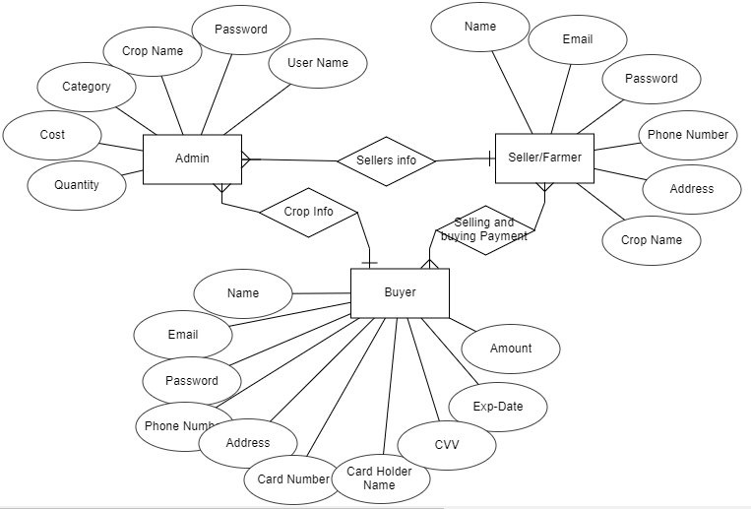
Design – ER Diagram
The ER diagram was created to help grasp the entire scenario. It was used to conceive the actions, and interactions between numerous entities.

Slide 18
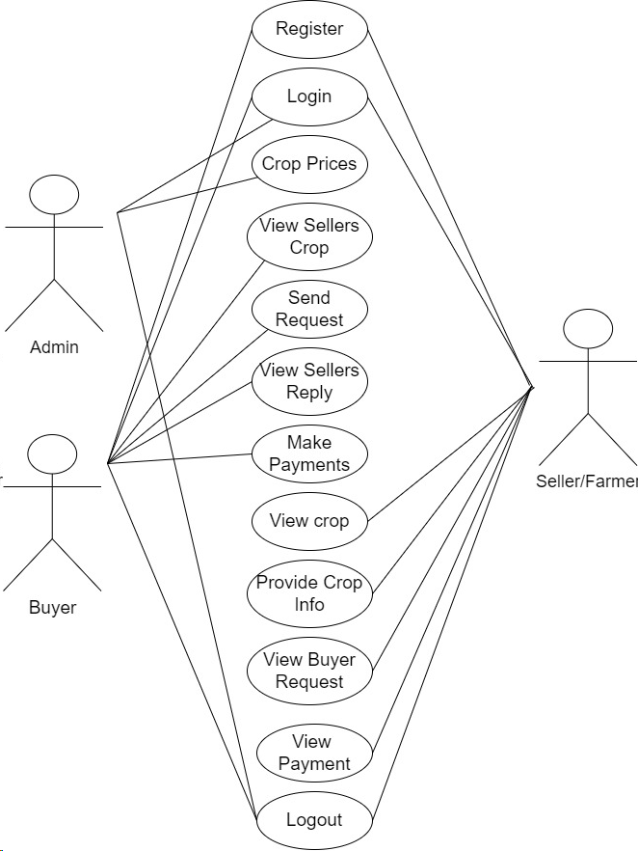
Design – Usecase Diagram
.

Slide 19
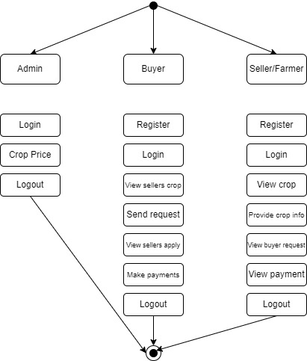
Design – Activity Diagram
.

Slide 20
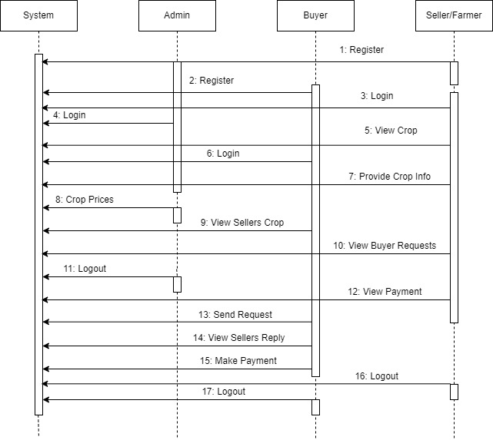
Design – Sequence Diagram
.

Slide 21
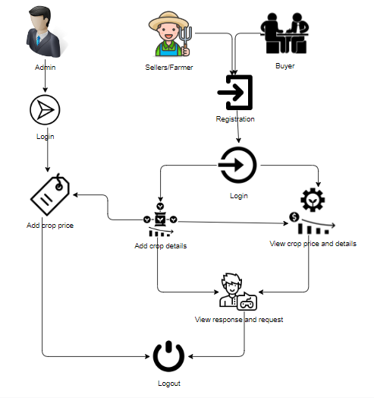
Design- System Architecture

Slide 22
Modules
To develop a decentralized traceability for agriculture supply chains, break down the functionality into several modules for the different user roles: Buyer, Seller, and Admin. Here are the modules for each role:
Buyer:
Register: The buyer will register with their details like name, email, password, address, contact, so after that the buyer will login.
Login: After registration the buyer will login with their details.
View seller’s crop info: Once the sellers will add the details the buyer can view those details here.
Send Request to Seller: If the buyer wants the details of crop then buyer will send request to seller.
View Seller Requests: Displays responses from sellers to the buyer's requests.

Slide 23
Modules
Make Payment: Once the seller accept the request for the crop the buyer has to pay the amount for that crop.
Logout: Allows buyers to logout securely.
Seller:
Register: The seller will register with their details like name, email, password, address, contact, so after that the seller will login.
Login: After registration the seller will login with their details.
Provide Crop Information: The seller will add there crop details like (crop name, crop category, and quantity and quality).
View Buyer Requests: When the buyer will send the request for the crop, here the buyer will view and he/she has to accept the request.

Slide 24
Modules
View Payments: Once the buyer will pay the amount for the crops. The seller can view the details of the payment.
Logout: Allows sellers to logout securely.
Admin:
Login: The admin will login with default email and password.
Crop price: The admin is the person he/ she will add the crop price for each and every crop details with that crop name, category, minimum cost and quantity.
Logout: Allows the admin to log out securely.

Slide 25
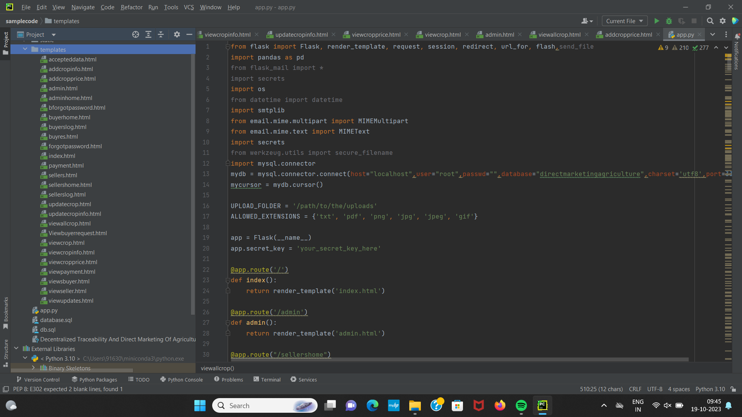
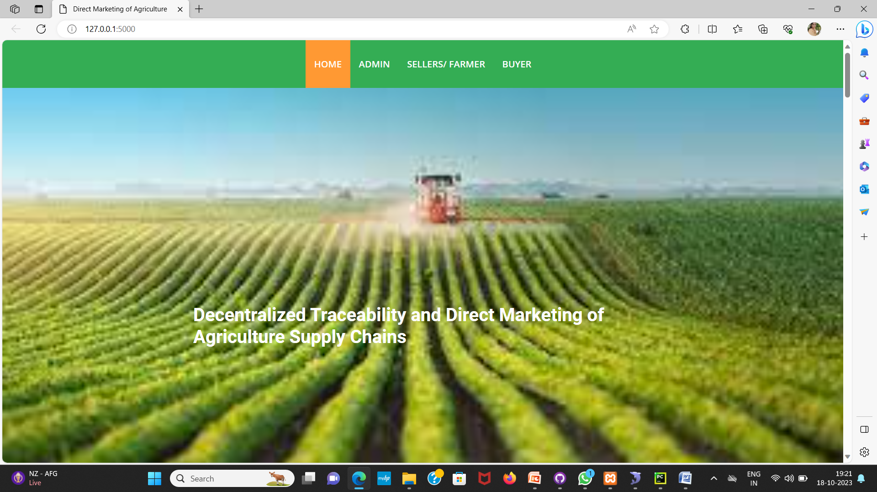
Implementation
Code and Ouput of the home page

Slide 26
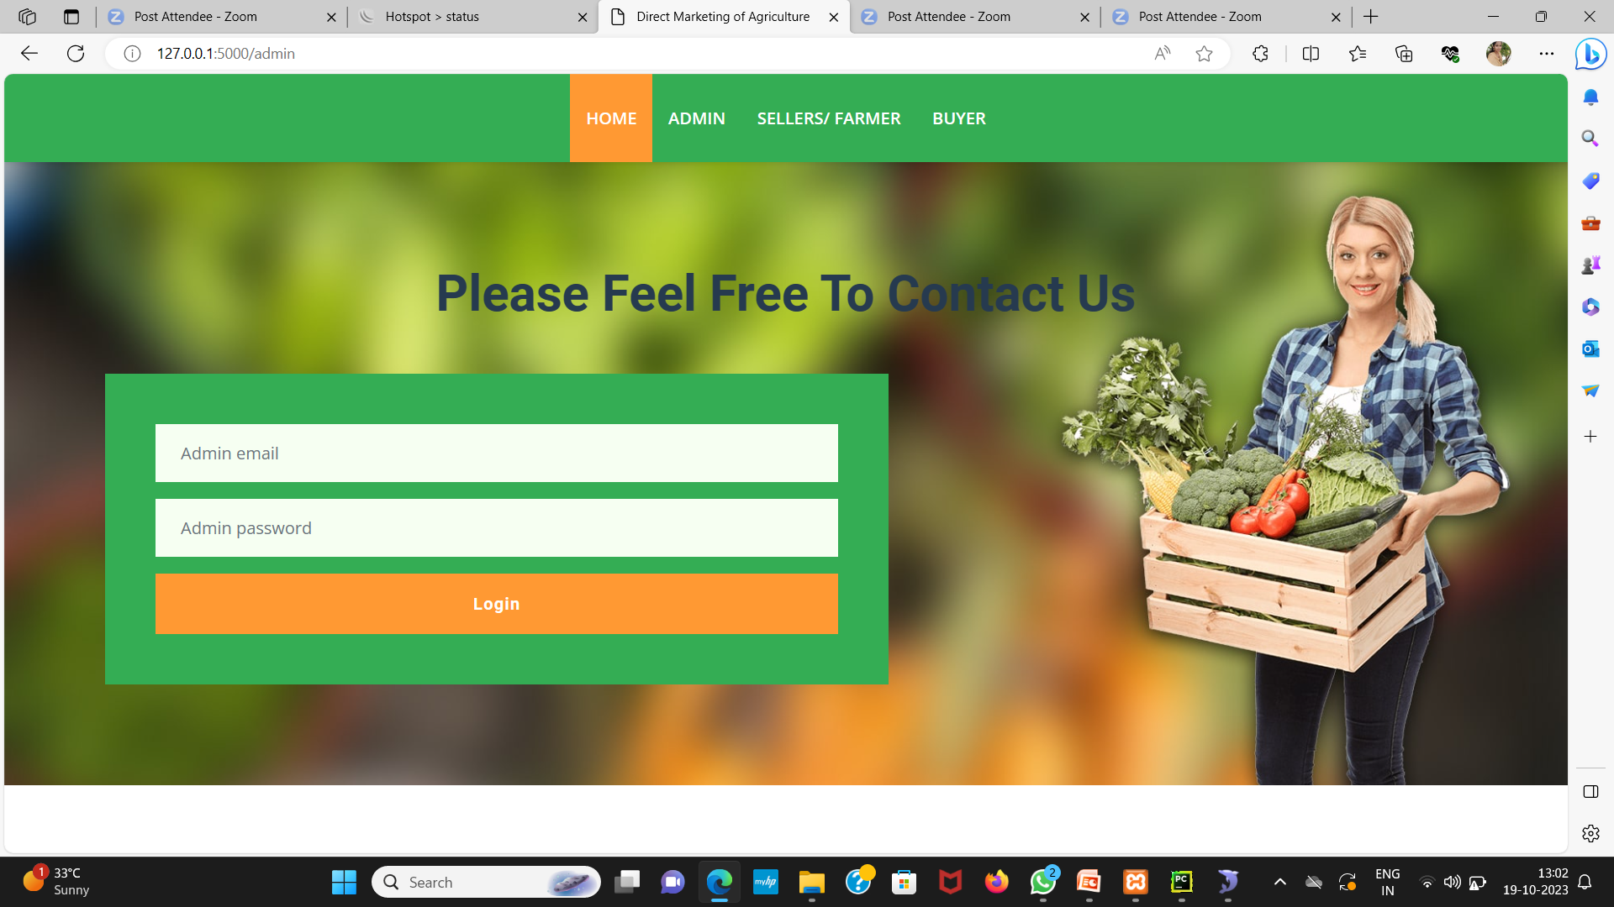
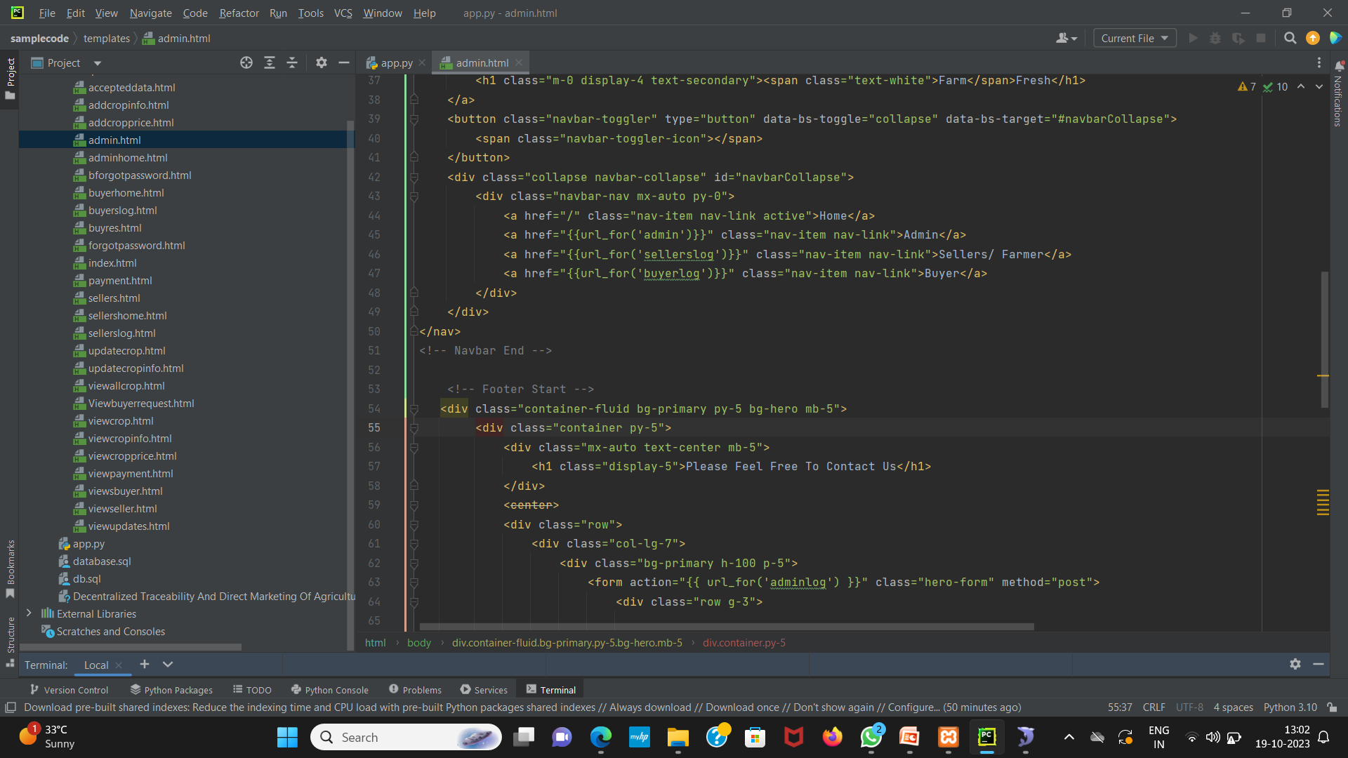
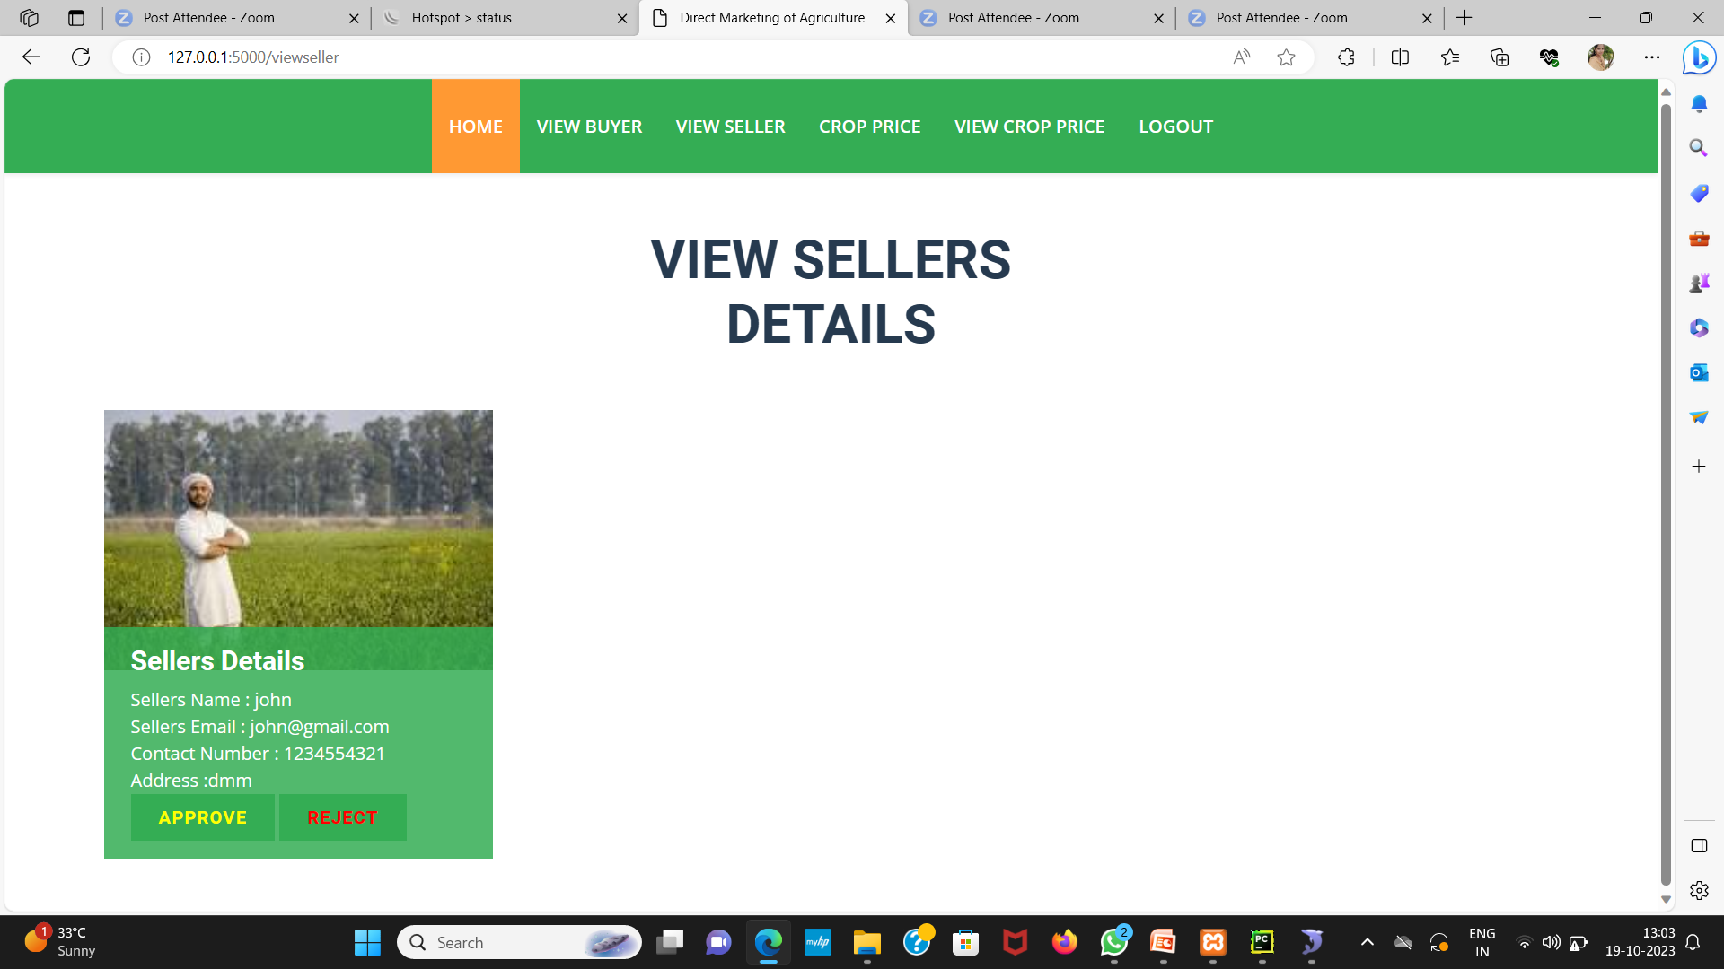
Implementation
Admin’s login page

Slide 27
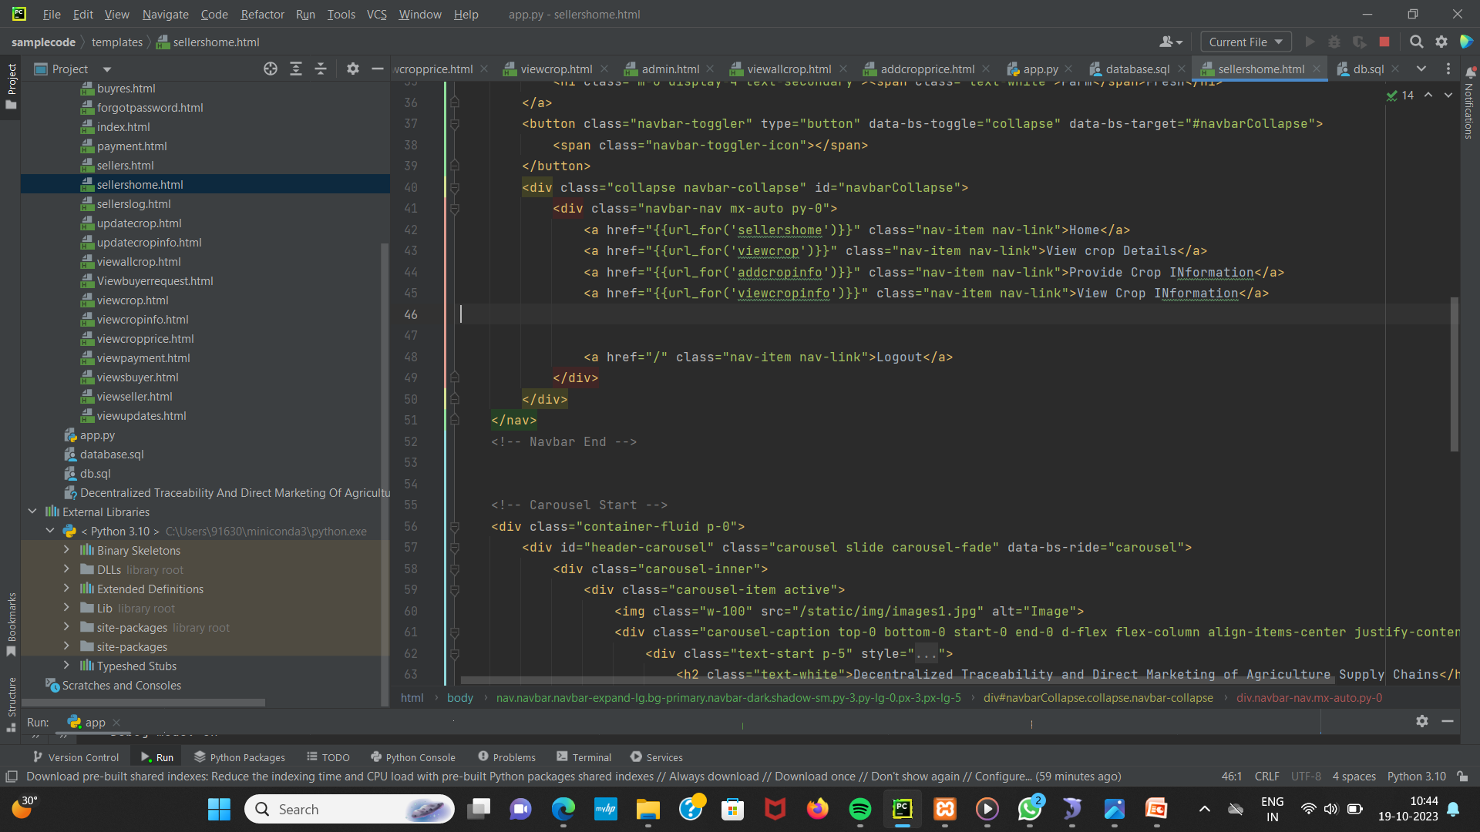
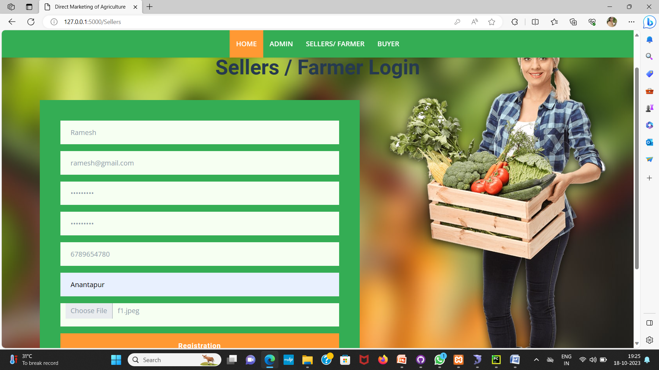
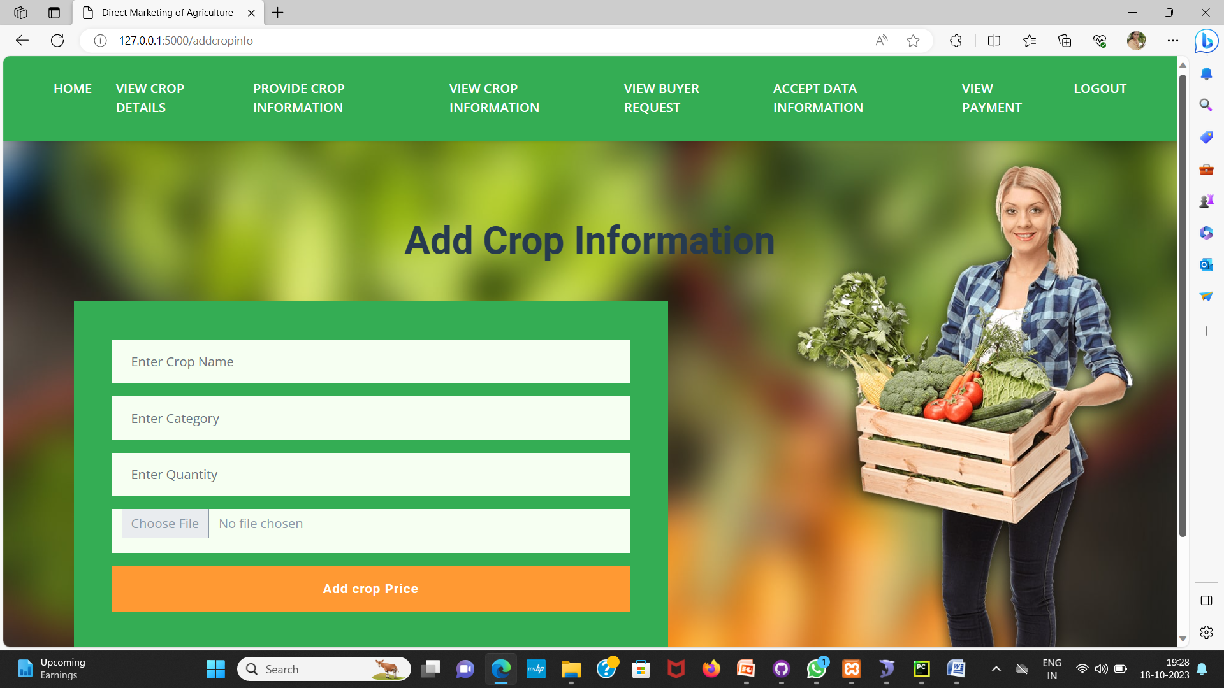
Implementation
Output pages of the seller registration and login details

Slide 28
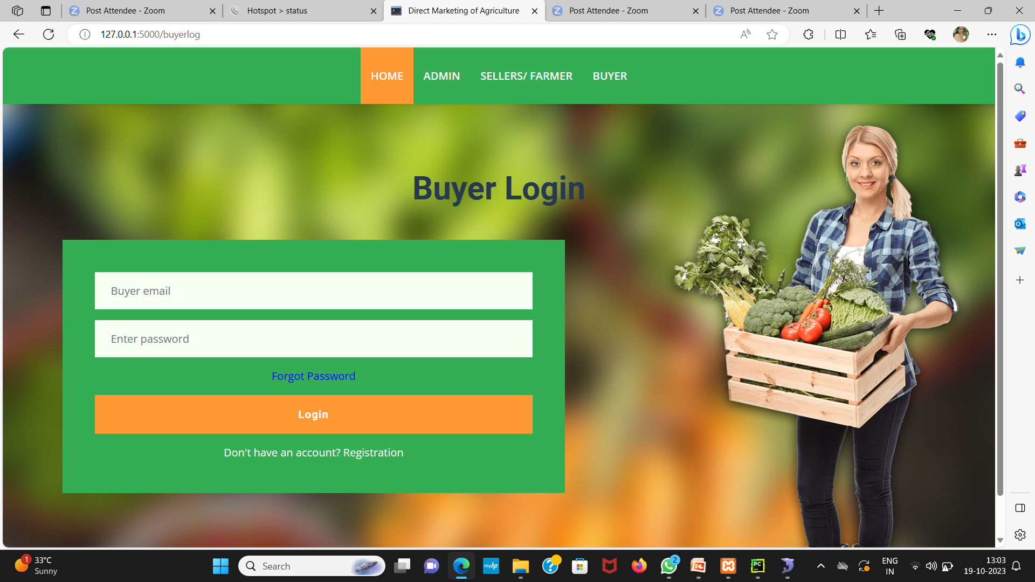
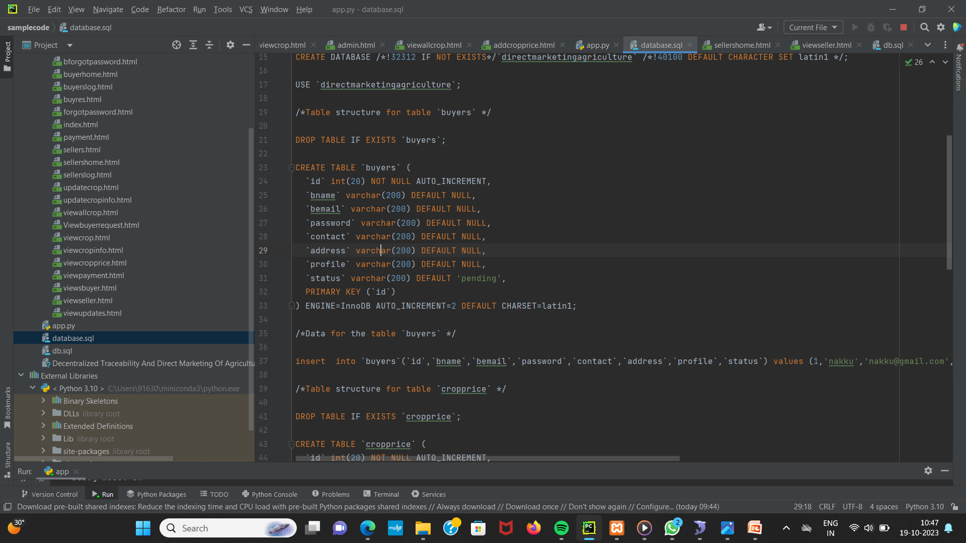
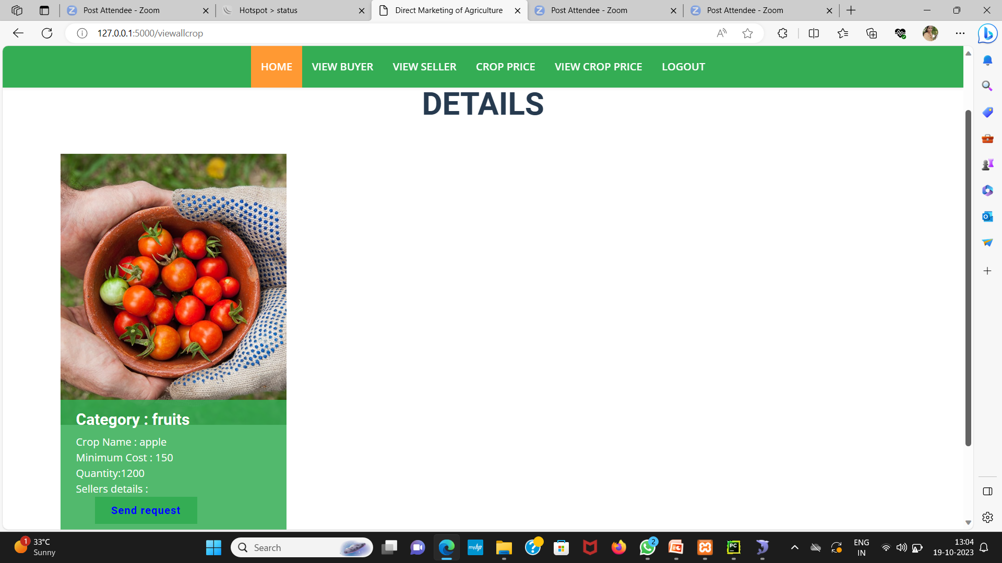
Implementation
Buyer registration and login details

Slide 29
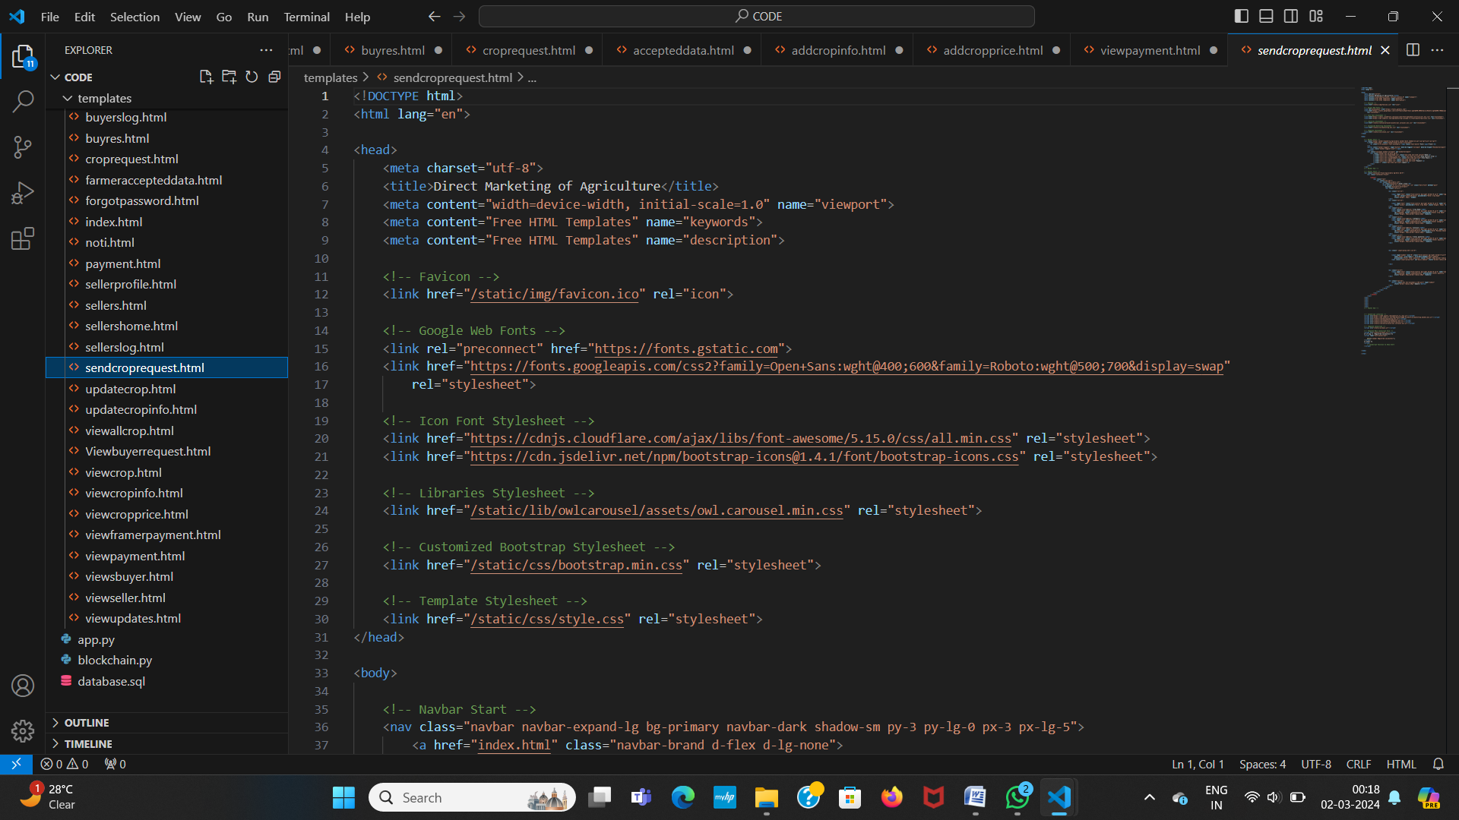
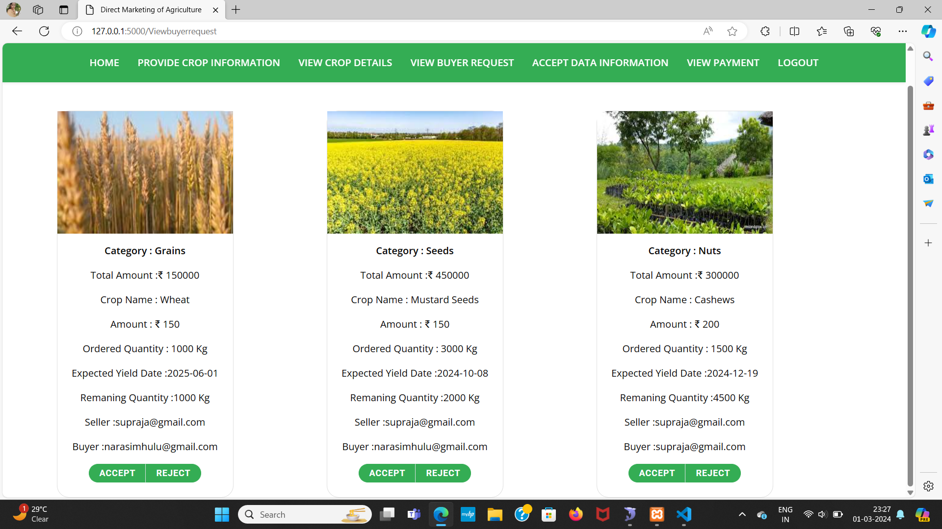
Implementation
Sending request

Slide 30
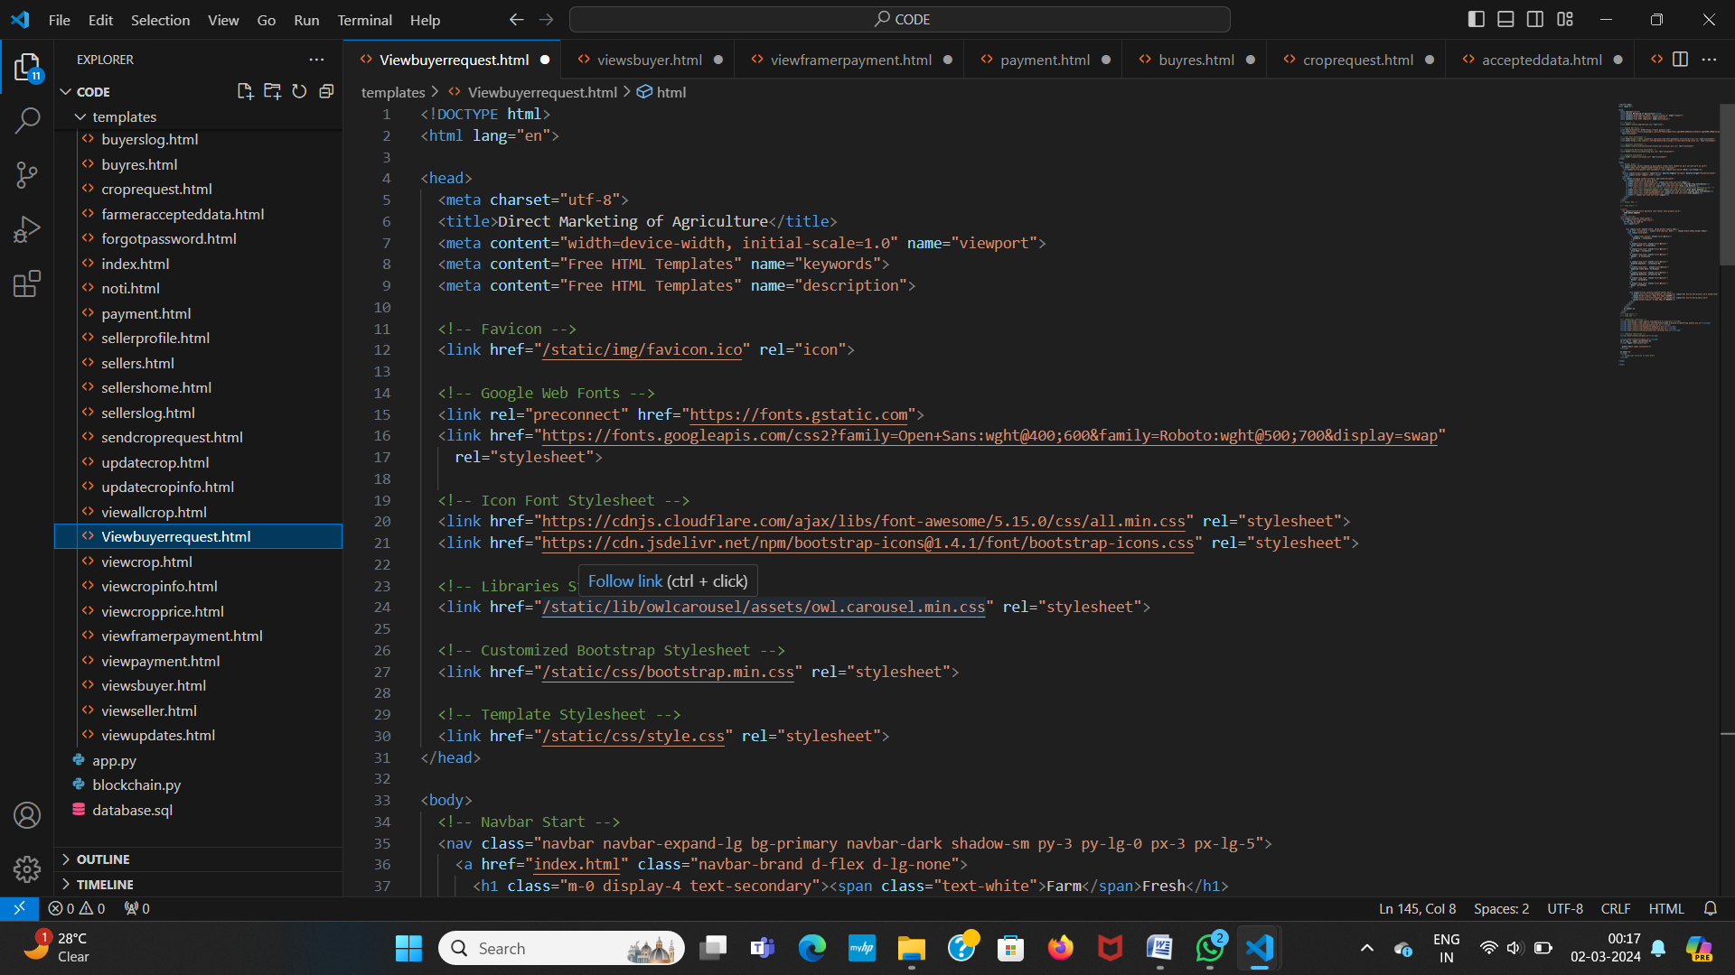
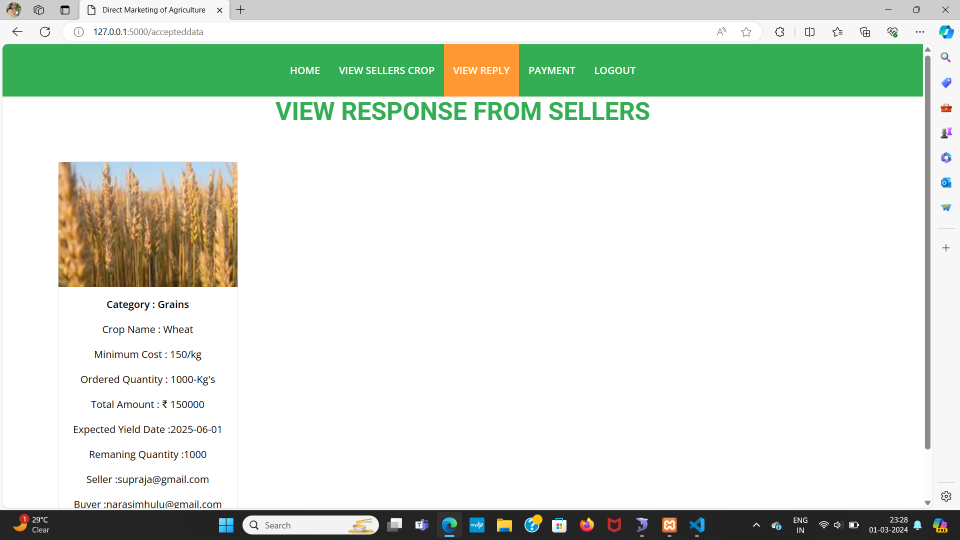
Implementation
Viewing response from selllers

Slide 31
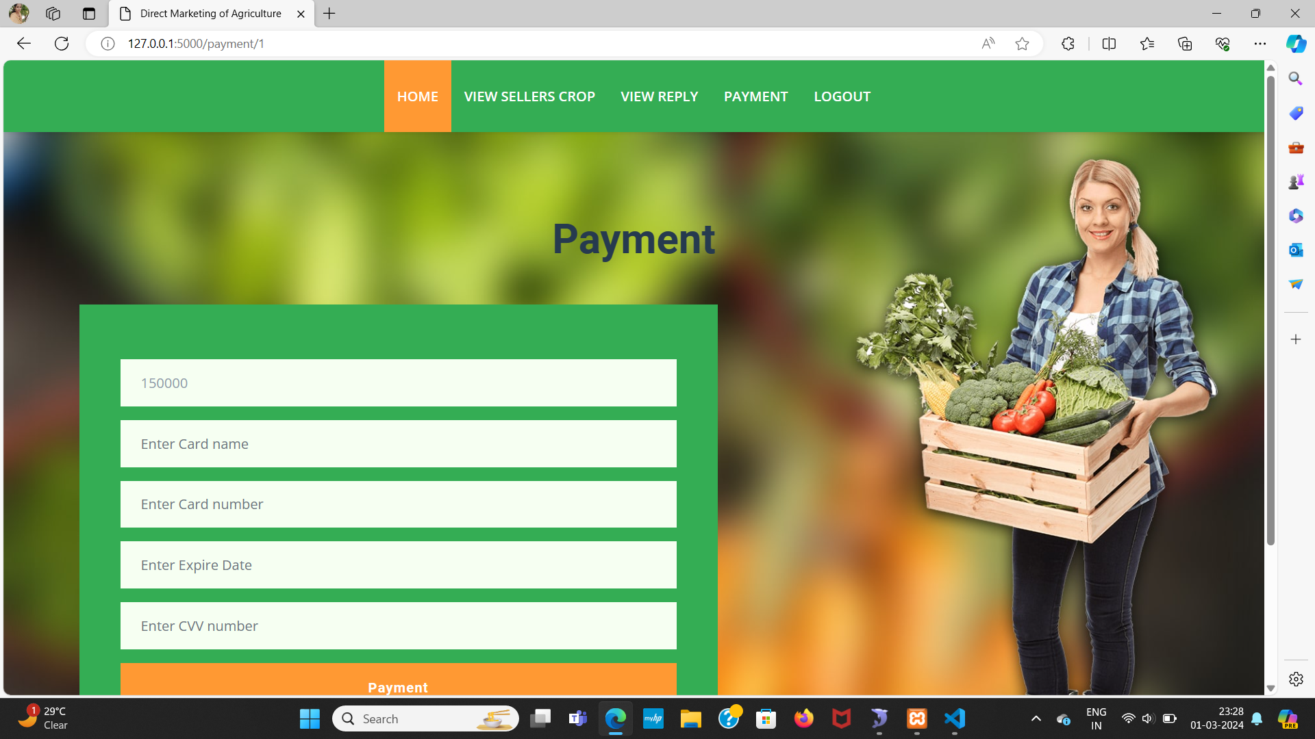
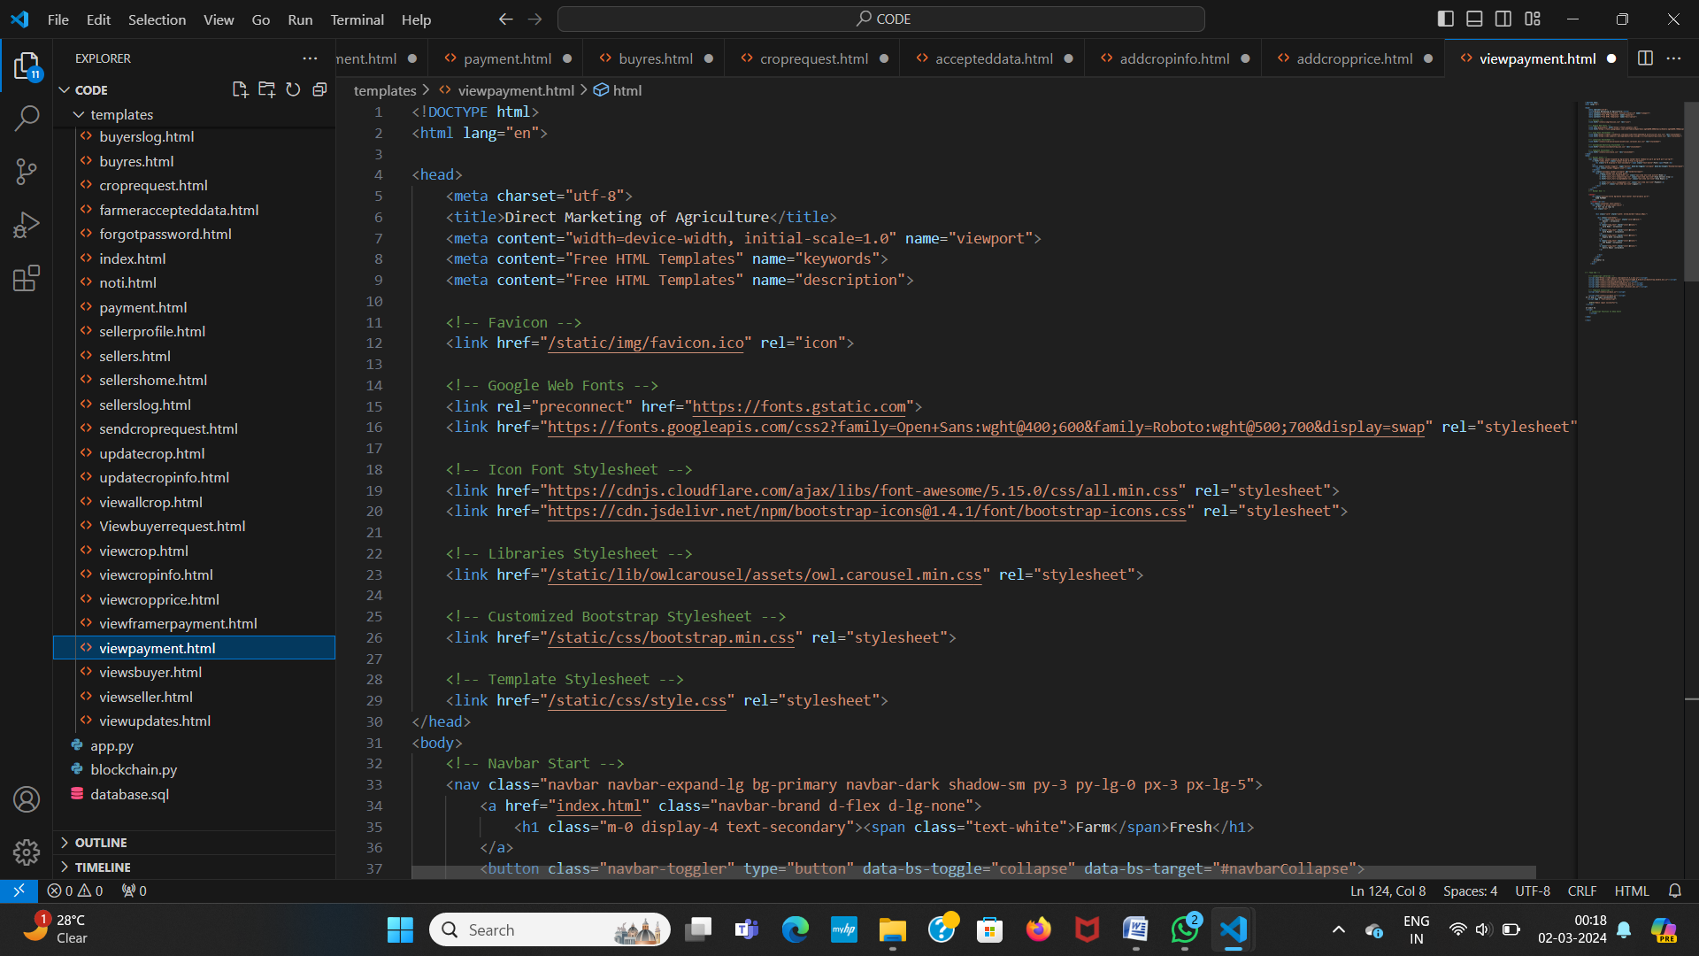
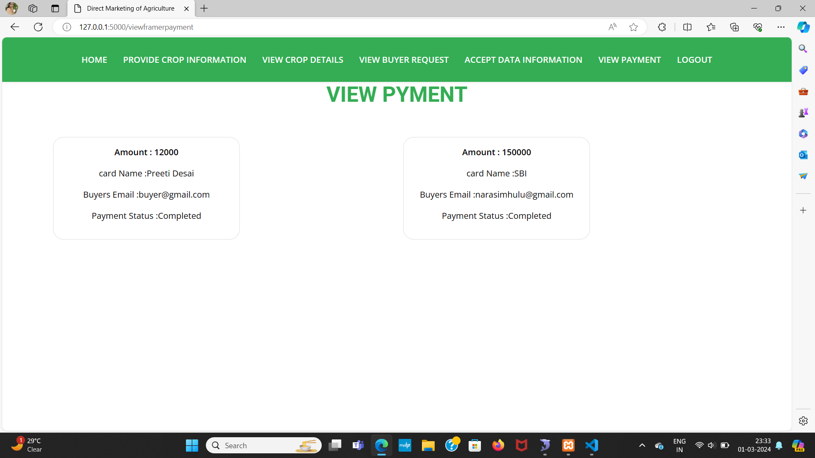
Implementation
Payment and status

Slide 32
Research Paper
Research paper

Slide 33
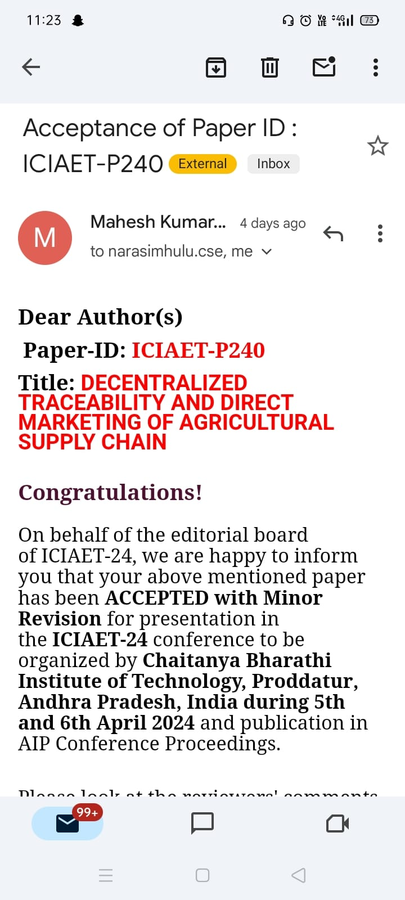
Acknowledgment

Slide 34
References
[1] Shivendra, Chiranjeevi, Tipathi, M.K & Maktedar, “Blockchain Technology in Agriculture Product Supply Chain”.
[2] K. Salah N. Nizamuddin R. Jayaraman and M. Omar, "Blockchain-based soyabean traceability in agricultural supply chain" IEEE Access vol. 7 pp. 73295-73305 2019.
[3] M. P. Caro, M. S. Ali, M. Vecchio, and R. Giaffreda, ‘‘Blockchain based tarceability in agri-food supply chain management’’ in Proc. IoT Vertical Topical Summit Agricult.-Tuscany (IOT Tuscany), May 2018, pp. 1–4.
[4] F. Tian, ‘‘A supply chain traceability system for food safety based on HACCP, blockchain & Internet of Things,’’ in Proc. Int. Conf. Service Syst. Service Manage., 2017, pp. 1–6.
[5] J. Hao, Y. Sun, and H. Luo, ‘‘A safe and efficient storage scheme based on blockchain and IPFS for agricultural products tracking,’’ J. Comput., vol. 29, no. 6, pp. 158–167, 2018.

Slide 35
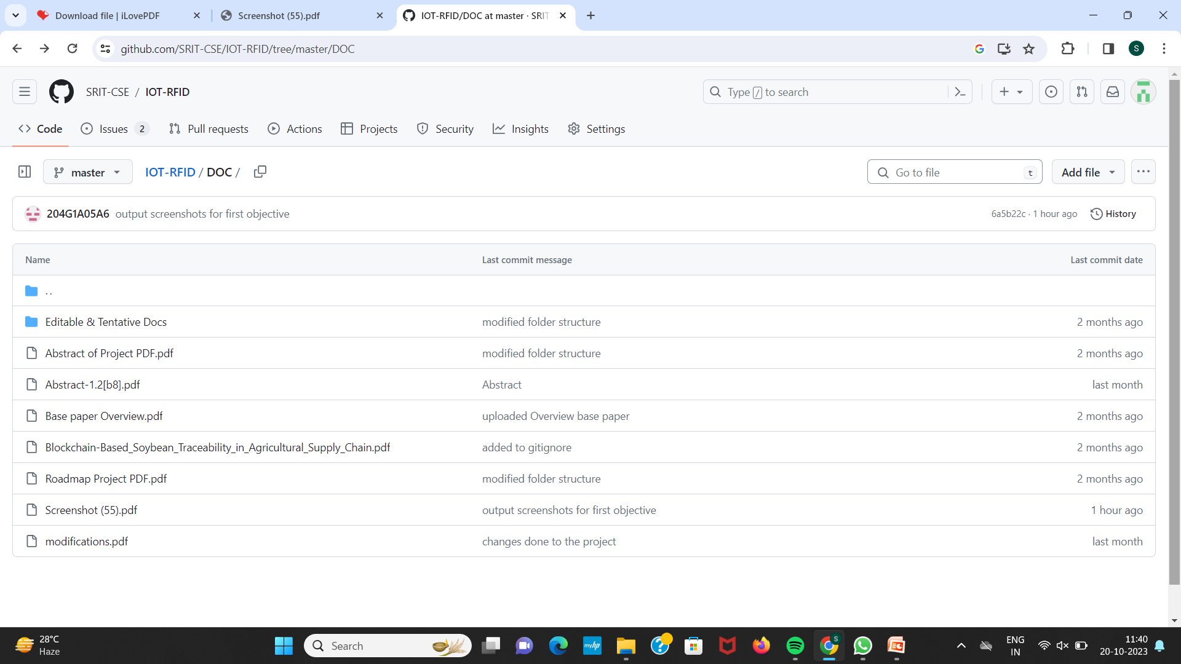
Git Hub Dashboards of each student
Github link: https://github.com/SRIT-CSE/IOT-RFID.git

Slide 36
Any Queries?

